Slide 1
SMART MIRROR WITH IN BUILT AI

Slide 2
TEAM MEMBERS :
DEVARINTI DHAPATLA PUNEETH REDDY - 20BCE1852
SANJIL K C - 20BCE1855
LENIN VASAN - 20BCE1892
SWETHA ANBALAGAN - 20BCE1978

Slide 3
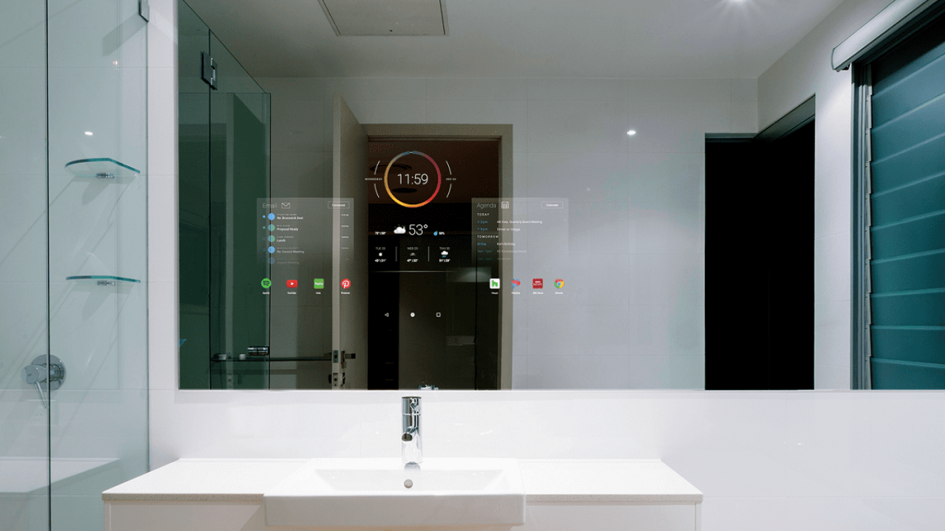
introduction
What if we say that you can do everything that you do with your mobile phone on a mirror, yes it’s possible with a smart mirror which uses android as its operating system ,it can be a mirror and a smart phone whenever you wish. The main goal of this gadget is to make the most of your time And keep you entertained .
It is designed in a fascinating way and it has many apps to keep you entertained whenever you need. It also has an in-built AI which will make your tasks easier ,you just have to say the magic word.

Slide 4
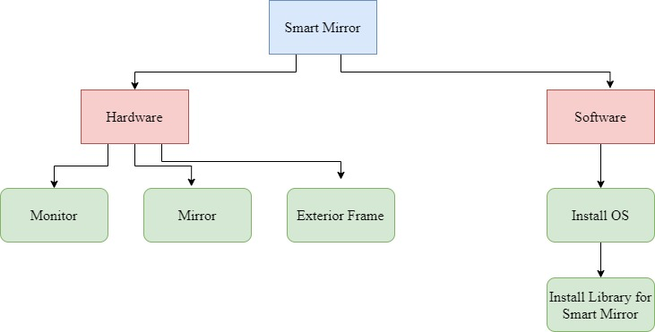
MIND MAP

Slide 5
PROBLEM STATEMENT The major problem of any existing mirror is displaying just the object in front of it or just the human face without having to interact with them. This project is developed with the intention that people spend quality time in front of the mirror.

Slide 6
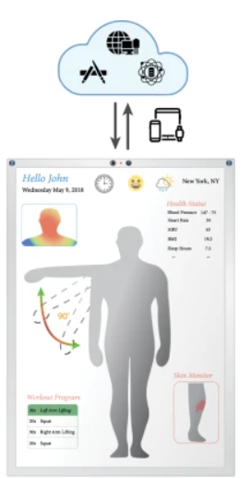
Prototype

Slide 7
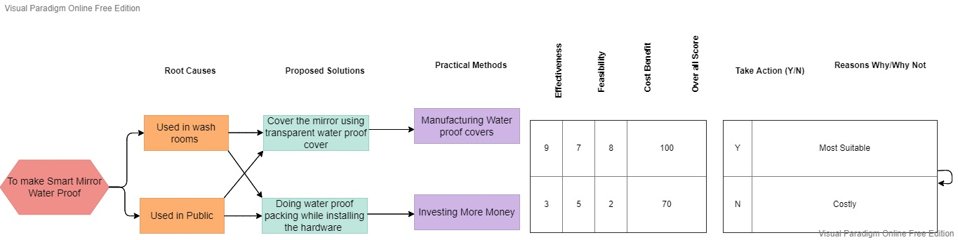
SELECTION MATRIX

Slide 8

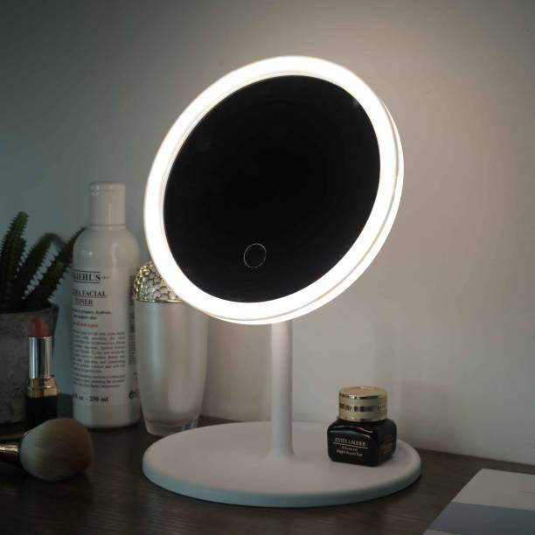
BUSINESS MODEL CANVAS
KEY PROPOSITIONS OF THE GADGET
Platform for entertainment.
Platform for education.
Voice assistance for saving time.
Information about anything, anywhere.
KEY PARTNERS
Suppliers of raw materials for the product.
Investors for the growth of the product.
Technological advancements.

Slide 9
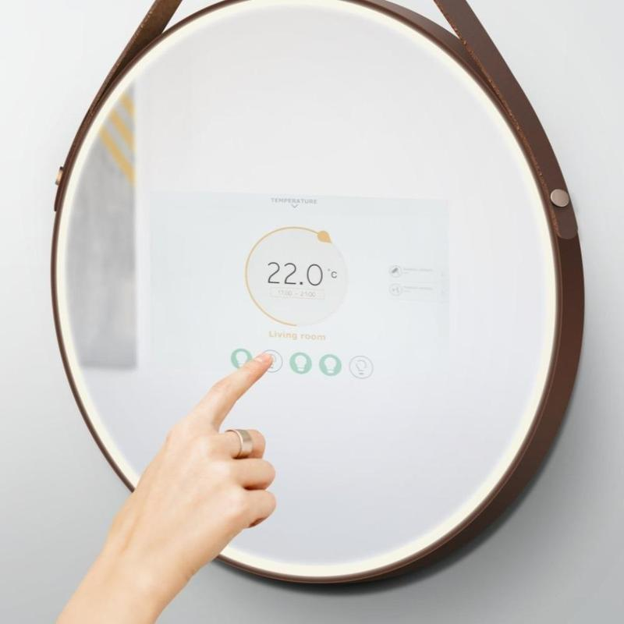
KEY ACTIVITIES
Marketing of the product.
Unique designing of the product.
Developing and improving the technology used.
Making the product available online (ecommerce).
KEY RESOURCES
Platform for entertainment.
Platform for technology.

Slide 10
PRODUCT SPECIFICATIONS
To build a smart mirror, you need three main components: a two-way glass/acrylic surface to act as a mirror, a display such as a PC monitor or smartphone/tablet, and a device to run the mirror’s software

Slide 11

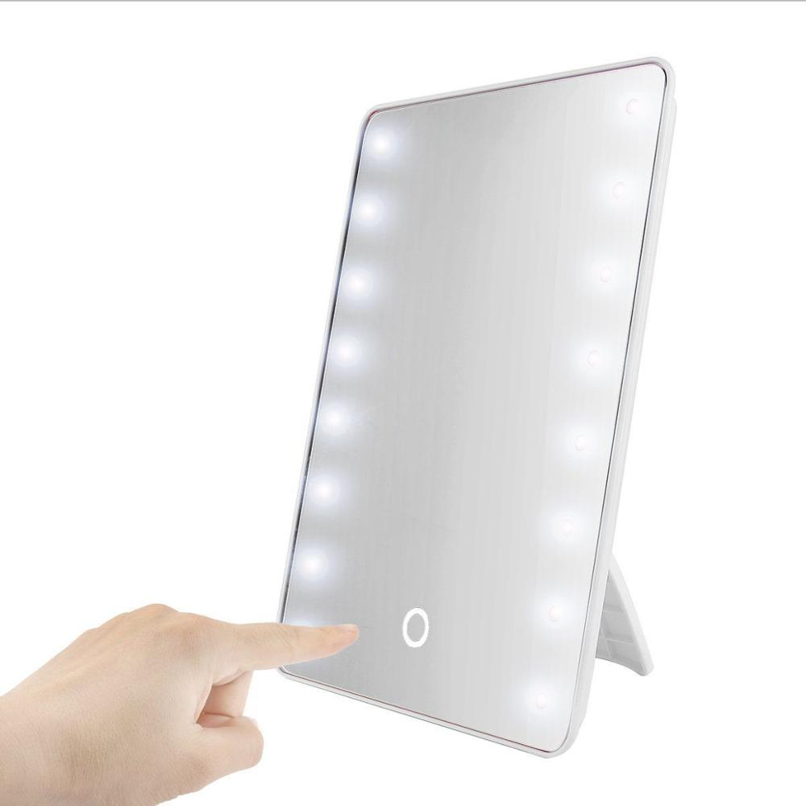
CUSTOMER RELATIONSHIPS:
We are planning to interact with customers using our device more often than other products and we are planning to do that by:
Feedbacks and rating.
Customer service.
24/7 assistance.
CUSTOMER SEGMENTS:
Clients interested in technology.
Clients interested in entertainment.
Age group target: 18-40 year of age.

Slide 12


CHANNELS
Our product will be reached to our customer through Websites, Ads and Apps.

Slide 13
CONCEPT GENERATION
Smart mirrors feature a digital display behind the glass and connect to your phone via Bluetooth or WiFi. Through this display, you can typically get information such as the date and time, daily news, weather forecasts , traffic reports and some apps

Slide 14
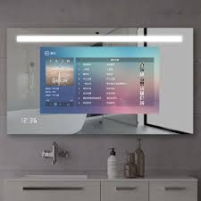
COST STRUCTURE
Designing : We will be spending amount on the design of the product. The design will depends on customer choice. While purchasing, we will be giving a list of design and from that, the customer can choose any design.
Technology used : We have used technology which sounds like a smart phone and there is an inbuilt voice assistant in the mirror.

Slide 15
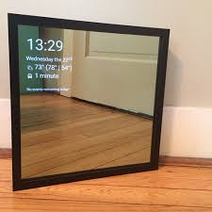
REVENUE SYSTEM
Our revenue system is based on the demand of the product.
And we will introduce some paid app which can be accessed by the smart mirror not on any other smart phone.

